Slide 1
PCEP Extensions for Establishing Relationships Between Sets of LSPs
draft-ietf-pce-association-group-03
Ina Minei | Edward Crabbe | Siva Sivabalan | Hariharan Ananthakrishnan | Dhruv Dhody | Yosuke Tanaka

Slide 2
Introduction
A generic mechanism to create a grouping of LSPs in the context of a PCE.
This grouping can then be used to define associations between sets of LSPs or between a set of LSPs and a set of attributes.
ASSOCIATION Object is defined for this purpose.
Can be carried in PCUpd, PCRpt, PCInitiate and PCReq.
Other documents define Association Types
WG - Diversity, Policy.
Individual - Protection, Bi-direction, VN, attributes, MBB, ECMP, multi-layer.

Slide 3
Associations
Dynamic Associations | Operator-Configured Associations
Associations that are created dynamically by the PCEP peers (E.g. Protection) | Association that are created by the operator manually (E.g. Policy)
The associations along with the set of LSPs are conveyed to a PCEP peer. | PCEP speaker then could ask for a LSP to join the operator-configured association. Association are known to the PCEP peer before hand via manual configurations.
The association identifier is allocated dynamically by the PCEP speaker | The association identifier, type, as well as the association source IP address is manually configured by the operator.
The association exist as long as the LSP state. | The association exist until removed manually by the operator.

Slide 4
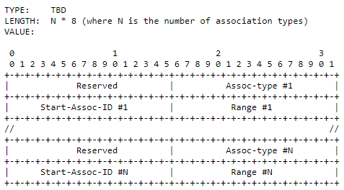
Operator-configured Association Range
For the association types that could be dynamic and operator-configured, it is necessary to configure a range of association identifiers that are marked for operator-configured associations to avoid any association identifier clash.
Dynamic associations MUST NOT use the association identifier from this range.
This range needs to be communicated to a PCEP peer in the Open Message.
Operator-configured Association Range - OP-CONF-ASSOC-RANGE TLV
Advertise the Operator-configured Association Range for an association type.
For association types that are only dynamic or only operator-configured, the TLV can be skipped.
Each association type can specify the default value for the operator-configured association range for their respective association type.

Slide 5
New Error Codes
Error-Type | Error-Value | Meaning | Remarks
Association Error | 1 | Association-type is not supported
 | 2 | Too many LSPs in the association group | Limit set by operator or local policy
 | 3 | Too many association groups
 | 4 | Association unknown | Used in PCReq
 | 5 | Operator-configured association information mismatch | Mismatch with local configured information
 | 6 | Association information mismatch | Mismatch with past information

Slide 6
Processing Rules
The association information is cleared along with the LSP state information.
When a PCEP session is terminated, after expiry of State Timeout Interval at PCC, the LSP state associated with that PCEP session is reverted to operator-defined default parameters or behaviors. Same procedure is also followed for the association information.
On session termination at the PCE, when the LSP state reported by PCC is cleared, the association information is also cleared.
Where there are no LSPs in a association group, the association is considered to be deleted.
In case the LSP is delegated to another PCE on session failure, the association information set by the PCE remains intact, unless updated by the new PCE.
Upon LSP delegation revocation, the PCC MAY clear the association created by the PCE, but in order to avoid traffic loss, it can perform this in a make-before-break fashion.

Slide 7
Summary of Updates
Removed the restriction on Association Source.
Error Handling
Dynamic and Operator-Configured Association.
Removed restriction of who could initiate association with LSP that do not share the Head node.
Operator-Configured Association Range.
Manageability and Security Considerations

Slide 8
Note to Association Draft Authors
State if the association-type is
Dynamic
Operator-Configured
Both
Incase of Both, set aside a default range for Operator-Configured Association.
Thanks!

Slide 9
Status and Next Step
Discussed with all association draft authors
Incorporated comments from Stephane, Rakesh, and Mustapha! Thanks!
More eyes and reviews are welcome!
Lets discuss IANA Early Allocation / Last Call?

Slide 10


